Slide 1




The Insurance Practitioner Apprenticeship

Slide 2







Agenda
10.30 - Welcome / CPD
10.35 - Overview of Apprenticeship
  Syllabus
  Academic Calendar
  Timetable of Lectures
  Examinations/Assessments
Q&A
10.55 - WBL Case Studies/Tasks
11.05 A Supervisor’s Perspective

Slide 3
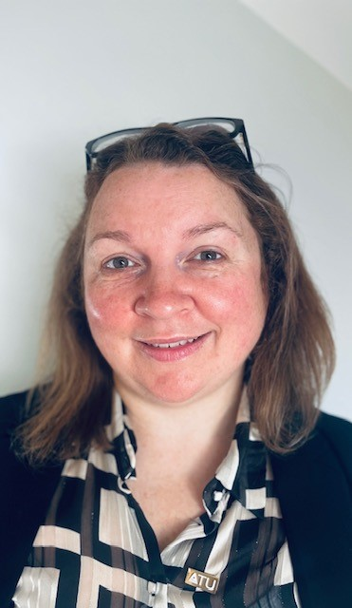
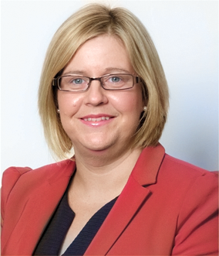
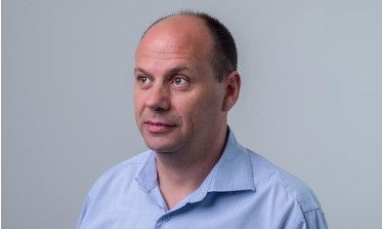
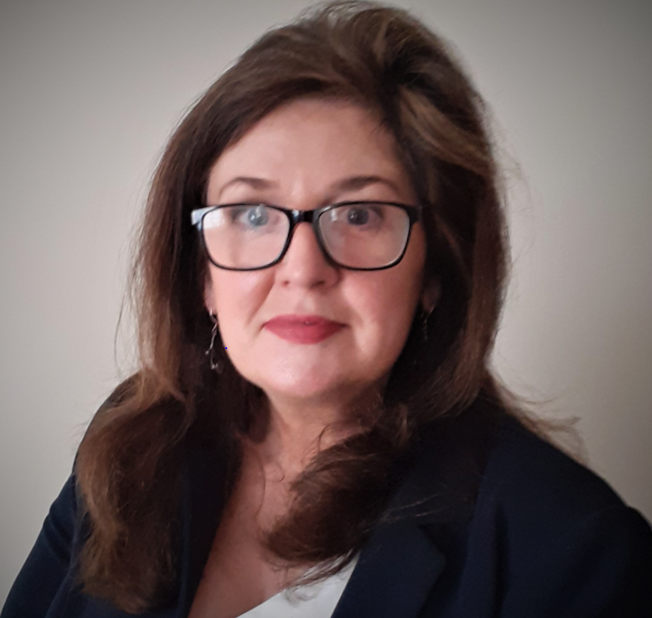

Meet the Team
Shane Keane
Education Coordinator
LIA
T: 01 7099849
E: apprentice@lia.ie
Naomi Gaffney
Client Support Manager
Insurance Institute
T: (01) 6456629
E: ngaffney@iii.ie
E: apprenticeship@iii.ie
Anne McGlynn
Curriculum Manager
T: 353 87 9180865
E: amcglynn@iii.ie
Rebecca Gillen
Apprenticeship Manager
Insurance Practitioner
Apprenticeships
ATU Sligo
T: (071) 9305877
E: Rebecca.gillen@atu.ie
Paula Hodson
Director of Education
& Development
E: phodson@iii.ie

Slide 4
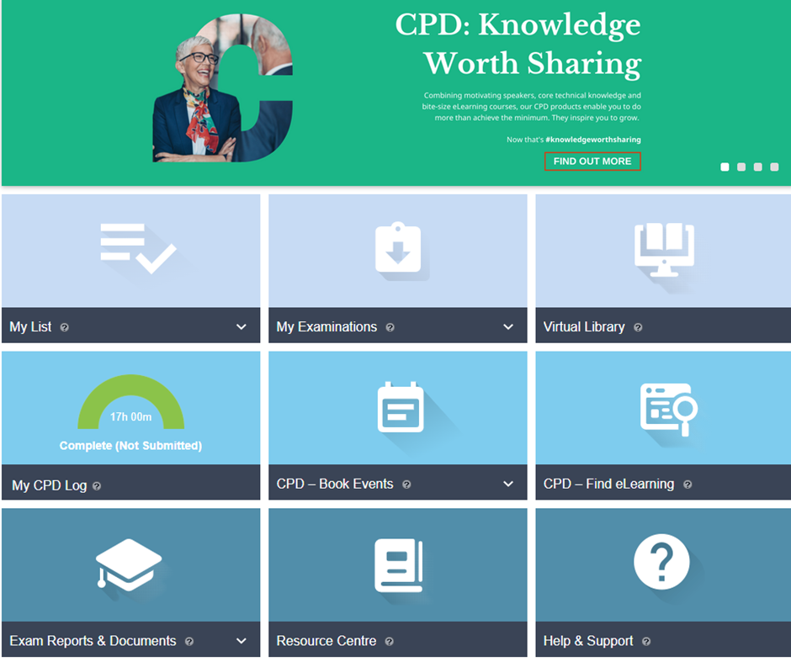
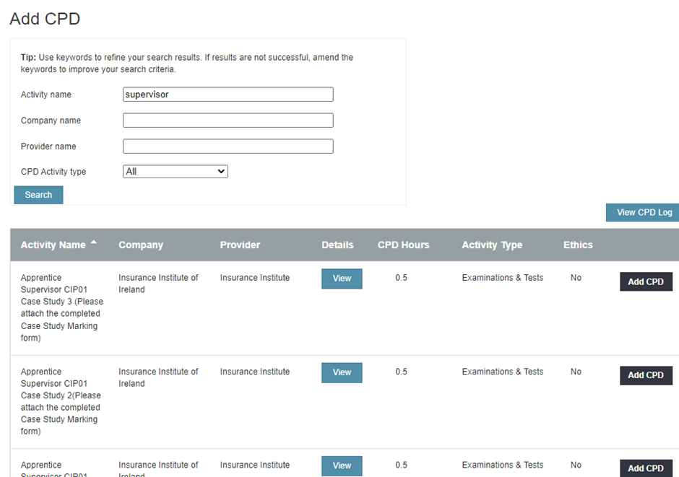

CPD
A maximum of 7.5 hours CPD per annum can be awarded to qualified supervisors for marking case study assignments.
If a supervisor has multiple apprentices, they can claim hours per apprentice for the correction of work.
In respect of APA/ CIP/ QFA/ ACII / FCII holders and Grandfathered persons, this breaks down as follows:
1. Up to max of 2.5 hours per semester (there are 3 semesters, i.e. Sept – Jan, Feb – May, June – Aug) or 30 mins per case study.
2. A member can add the CPD hours to their own CPD portfolio as the Institute has set up the events on Connect. A member can add a max of 15 such events to their CPD portfolios.
3. When adding the above named events, they must attach the completed evidence form (case study marking form, in pdf format)
4. Again, regardless of the number of apprentices a Supervisor has only a maximum claim of 7.5 hours can be allocated in any one calendar year for their Apprentice supervision work.
Choose the case study you have marked and add this to your CPD profile, please include the date as the due date of the case study.
Please upload the relevant sign off sheet of each case study as evidence, this must be a pdf document.
However, regardless of the number of apprentices a supervisor has only a maximum of 7.5 hours can be allocated in any one calendar year for apprenticeship supervision work.

Slide 5




A snapshot of the Insurance Apprenticeship
55
Youngest
apprentice
Females 51%
Males 49%
463
200
18
Oldest
apprentice
Highest percentage of Females in an apprenticeship
Age Profile
Apprentices
Graduates

Slide 6
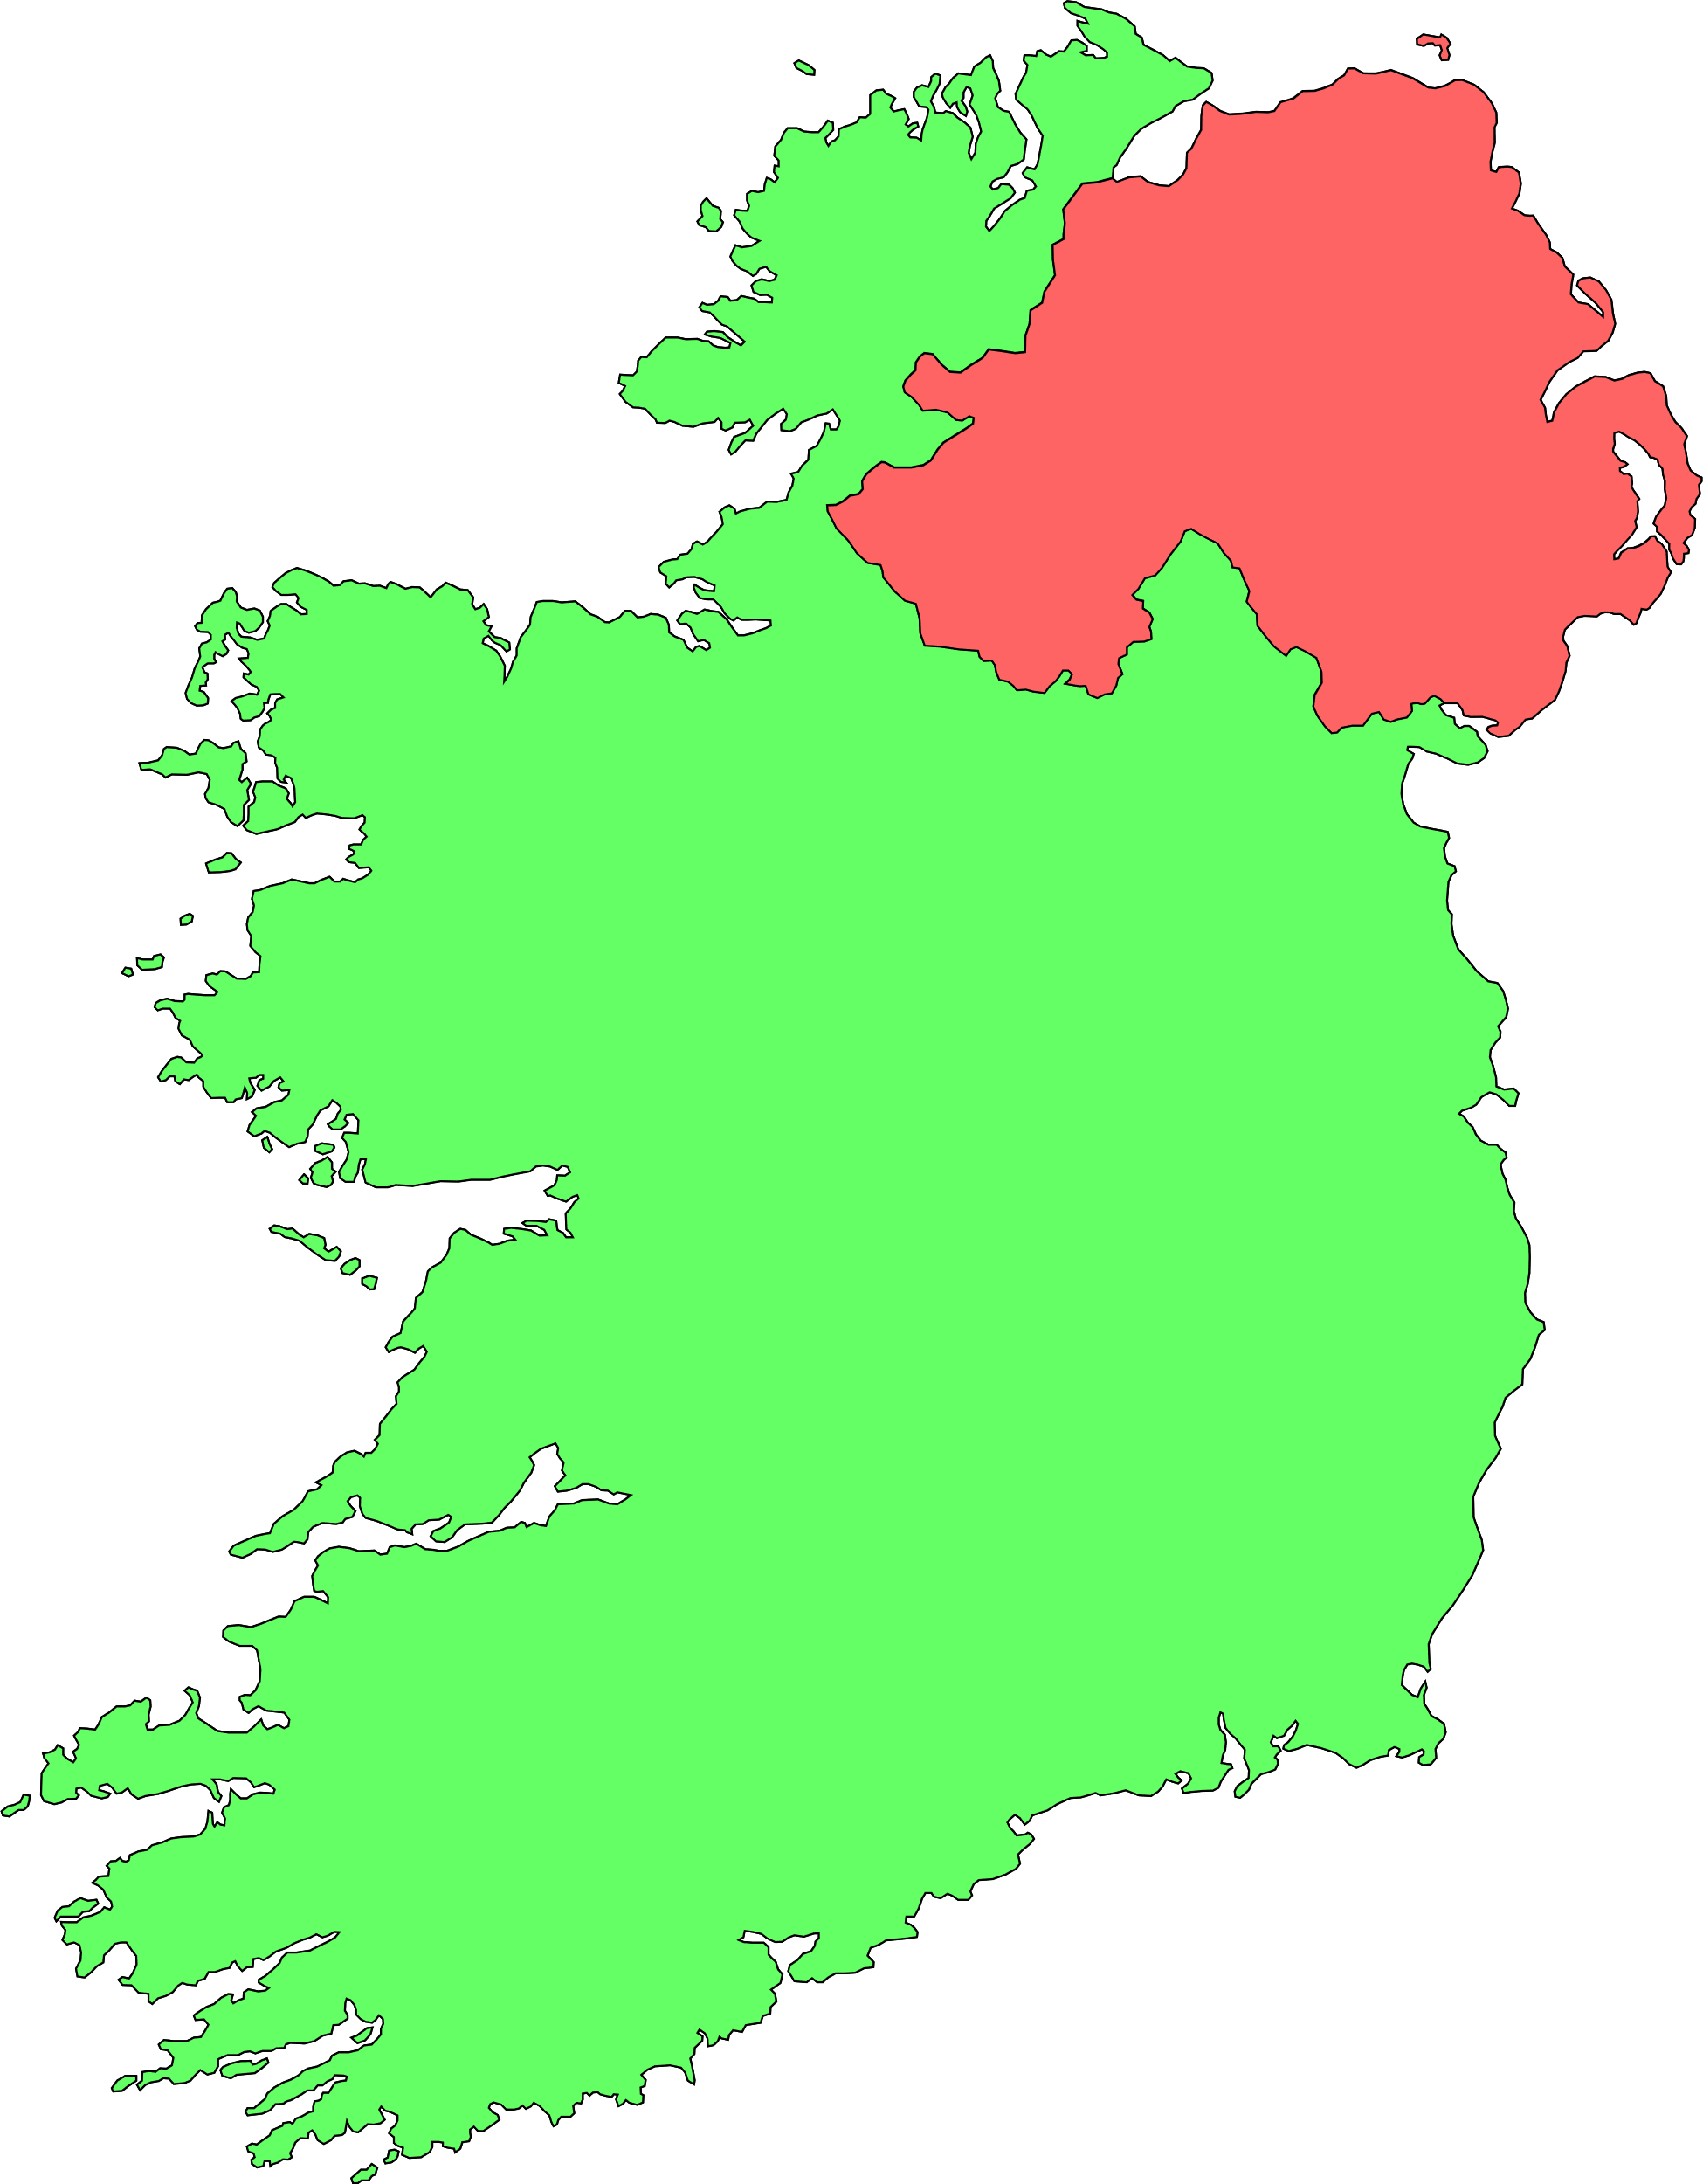
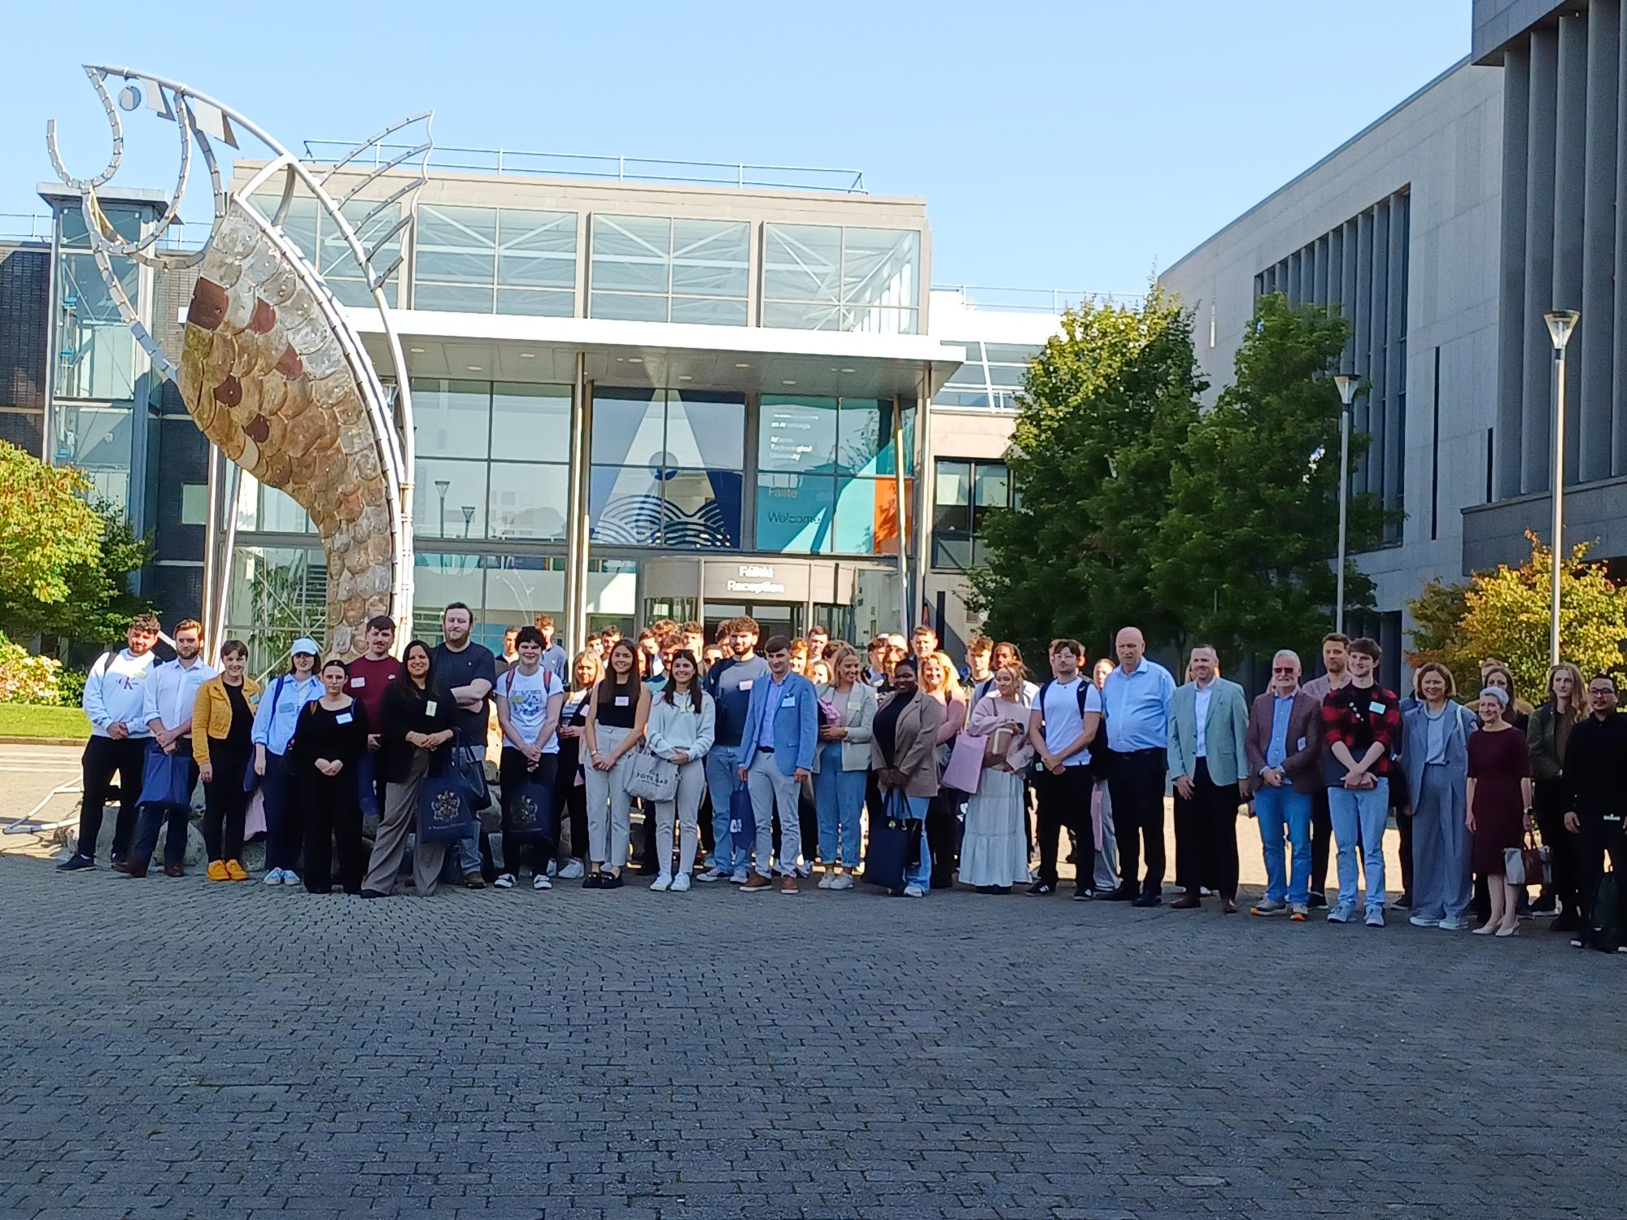
2024 Intake
100*
Apprentices’ country wide
* Final numbers still to be confirmed

Slide 7
Rebecca Gillen, Apprenticeship Manager, ATU Sligo
Introduction to new Apprenticeship Manager
Progress Reports

Slide 8
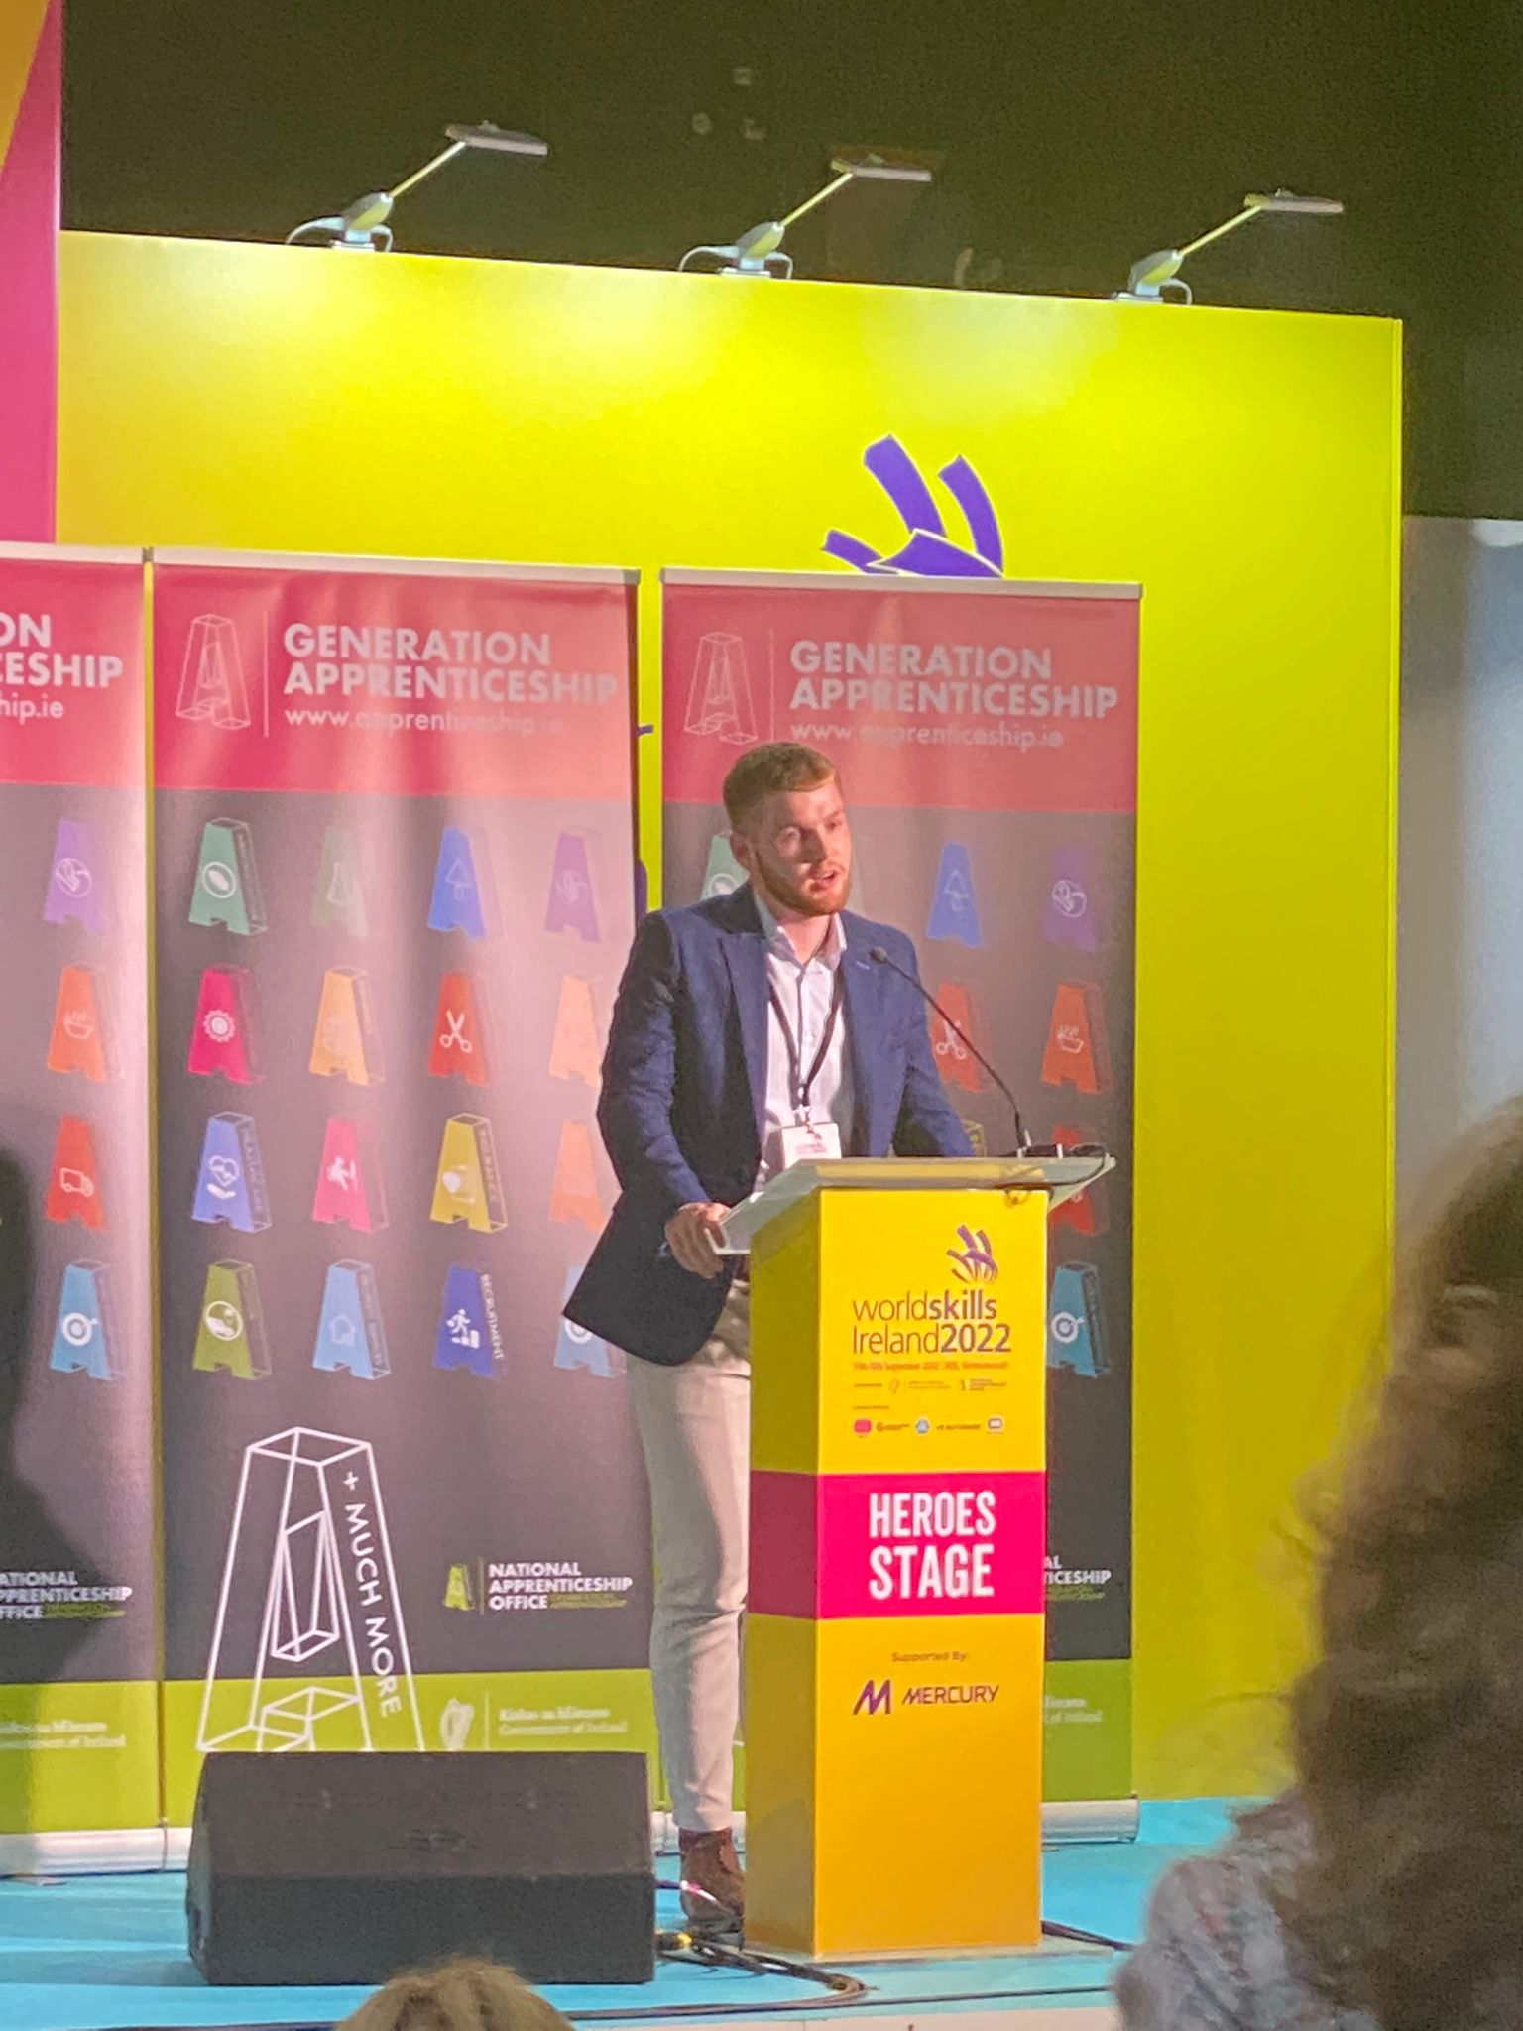
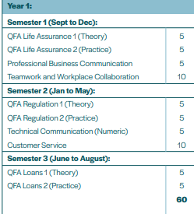
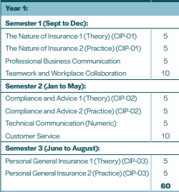
The Syllabus Life/General
REVENUE

Slide 9


Module Credits
All modules, both work-based learning (WBL) and business modules, in this degree have academic credits attached to them.
There are 180 credits at the end of 3 years.
Each WBL module is allocated 5 ECTs. Typically, 1 ECTS = 20-25 hours of total student effort.
Some Business Modules (and all in Year 3) are 10 ECTS.
It is crucial to be aware of the level of work involved. required particularly in third year.

Slide 10
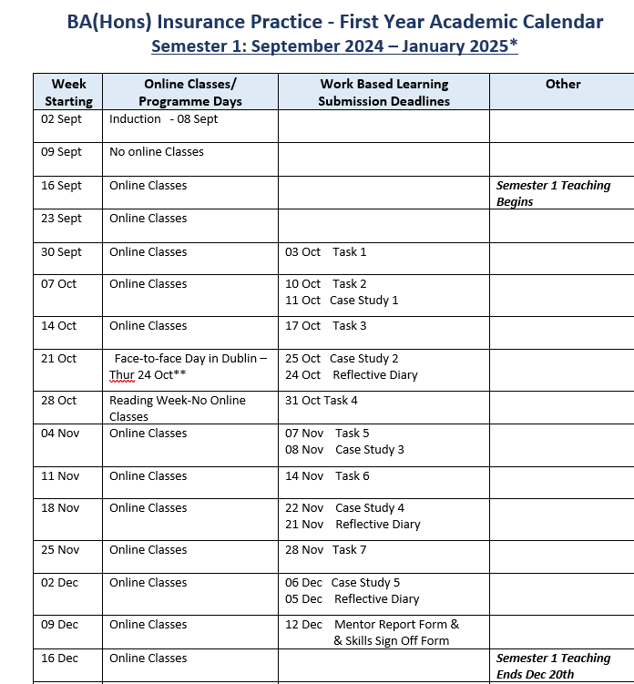

We have 4 face-to-face days.
One was Induction.
The rest are in Dublin
24th October
30th January
20th March

Slide 11
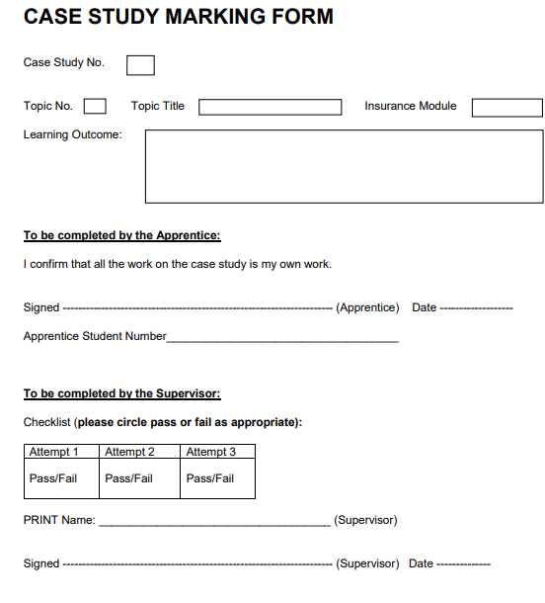
  You must complete one marking form per submission.
  ATU Sligo can be audited and must have CLEAR sign offs from supervisors.
  ATU Sligo will not accept pasted signatures.
  Easiest method is a short note stating case study number/diary month, etc.
  Work is acceptable. Ask your apprentice to provide you with a copy of the case study with their submission.
  A separate mail /sign off is required for each submission. This will discourage work being bulked together for approval.

Slide 12
A Typical Week for a New Apprentice

Slide 13
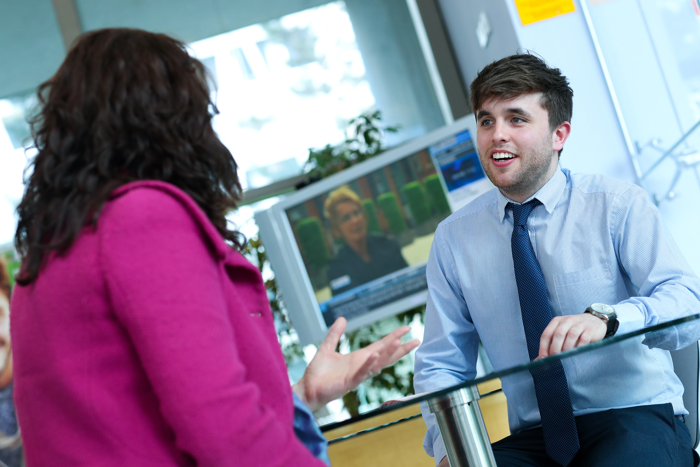
4 days a week – working in the team on the job
1 day per week
Academic Learning via ATU Sligo involving 3 streamed lectures 2.5 hours each in a quiet area in the office with access to a PC/Laptop
Complete Case 5 studies for CIP01/QFA life over the 13 week semester Complete WBL tasks & diary entry
Become familiar with work practice tasks

Slide 14

Every thing the apprentice needs is either in the guide (which you and all apprentices have received a copy of) or alternatively check out the Student Portal on the website.

Slide 15
End of Semester Reports

Slide 16
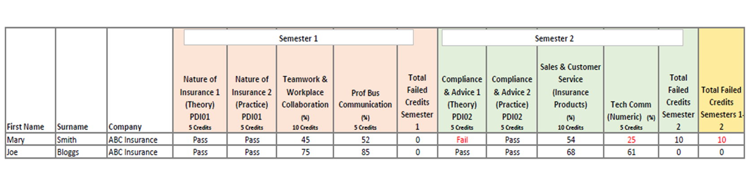
An apprentice cannot progress from 1st year to 2nd year if they have more than 10 failed credits. An apprentice cannot enter their 3rd and their final year if they have failed more than 10 credits or have an outstanding failed module from 1st year.

Slide 17
The Role of a Supervisor

Slide 18
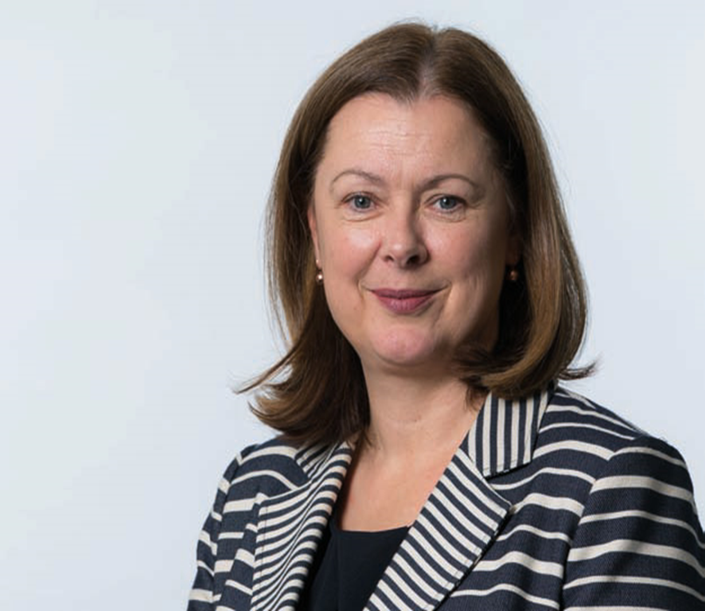
Welcome
Paula Hodson
Director of Education & Development

Slide 19
Apprentice’s Role Supervisor’s Role Mentor’s Role
Turn up each day!!!
Work on job allocated tasks for 4 days per week
Do online study lectures 1 day per week (reduced to a half day during summer semester)
Choose and work through case studies each semester
Keep reflective diary
Complete work-based tasks
Download and ensure assessment forms signed at required times
Have access to own computer/laptop outside working hours
Do self study weekly (10 hours)
Manage Moodle (ATU Sligo) and upload documents
Ensure apprentice attends work and online sessions
Acts as the day-to-day supervisor
Signs off on the work-based performance assessment forms for the on-the-job tasks and monitors their performance
Marks case study assignments using assessment framework
Record/exchange data as required (note this is student led)
Holds regular face-to-face observation of the progression and achievements of the apprentice
Support, guide and mentor the apprentice(s).
Act as liaison with ATU Sligo, LIA and III delivering the programme
Arranges job/team rotations (where possible)
Holds scheduled (every semester) face-to-face observation of the progression and achievements of the apprentice
Outcomes discussed with the Supervisor who records/exchange data as required (note this is student led)
Report concerns regarding apprentice as required
Notes:
Before we talk about the role of the Supervisor I want to just briefly mention the Apprentice.
Listed here are key aspects of what is involved for them and I was to remind us all of their
19

Slide 20
WBL Case Studies/Tasks
Best Practice – Examples

Slide 21
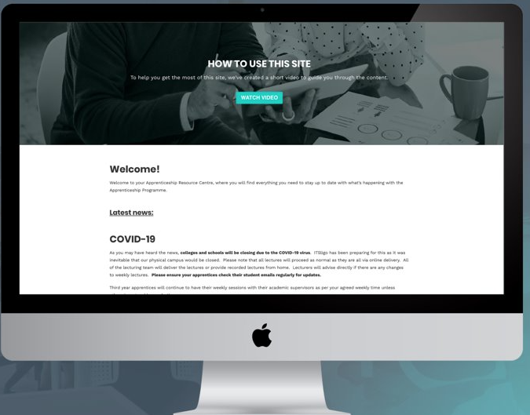
Supervisors’ Resource Centre
An email will be sent with a password after this session for access. The Resource Centre has copies of all relevant documentation
and information relating to the Insurance Practitioner Apprenticeship for both Life & Non Life Supervisors and Mentors. ​
The Resource Centre can be accessed through:
https://earnandlearn.ie/apprenticeships-employers​

Slide 22
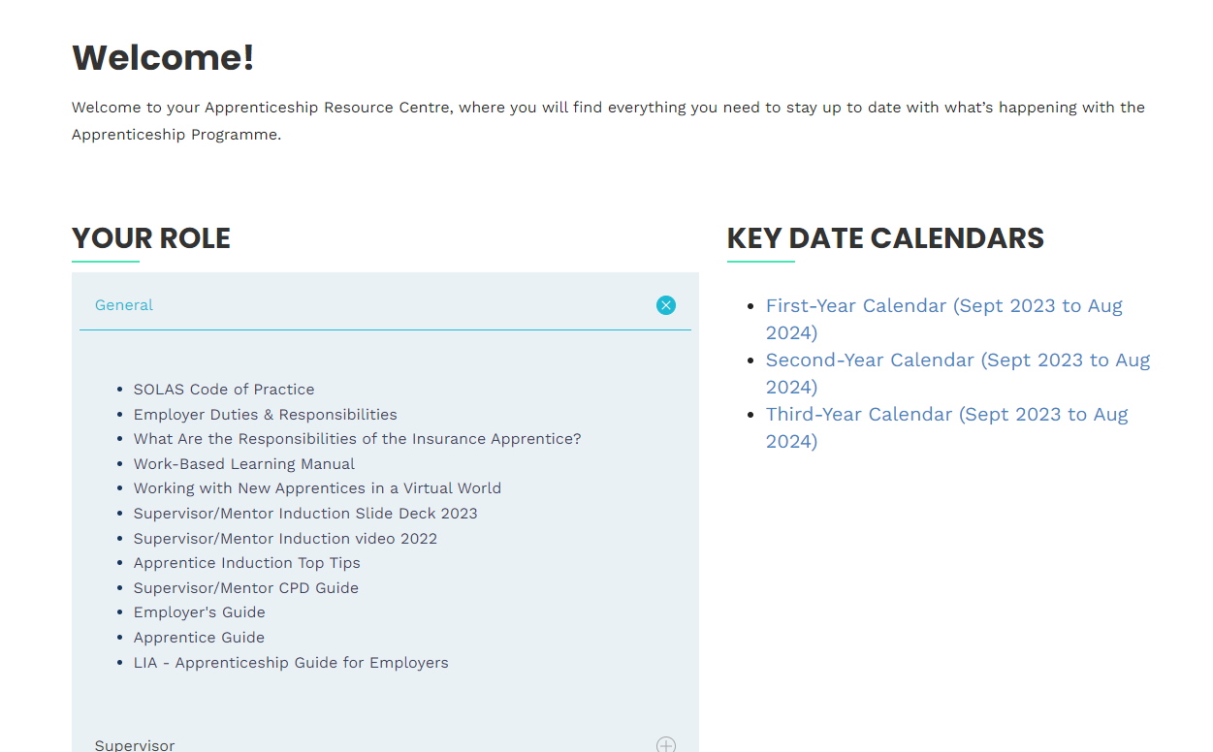
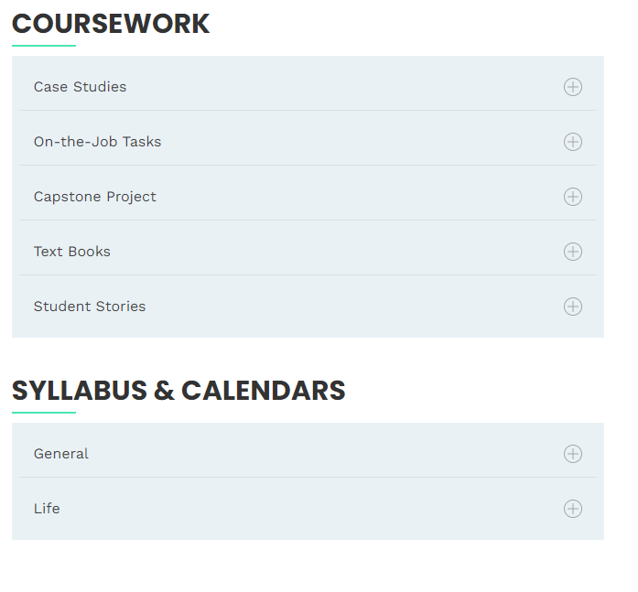

Slide 23
Schedule Time to sign off case studies and work-based learning.
In first year, there are weekly tasks to ensure the apprentice engages with their supervisor.

Slide 24
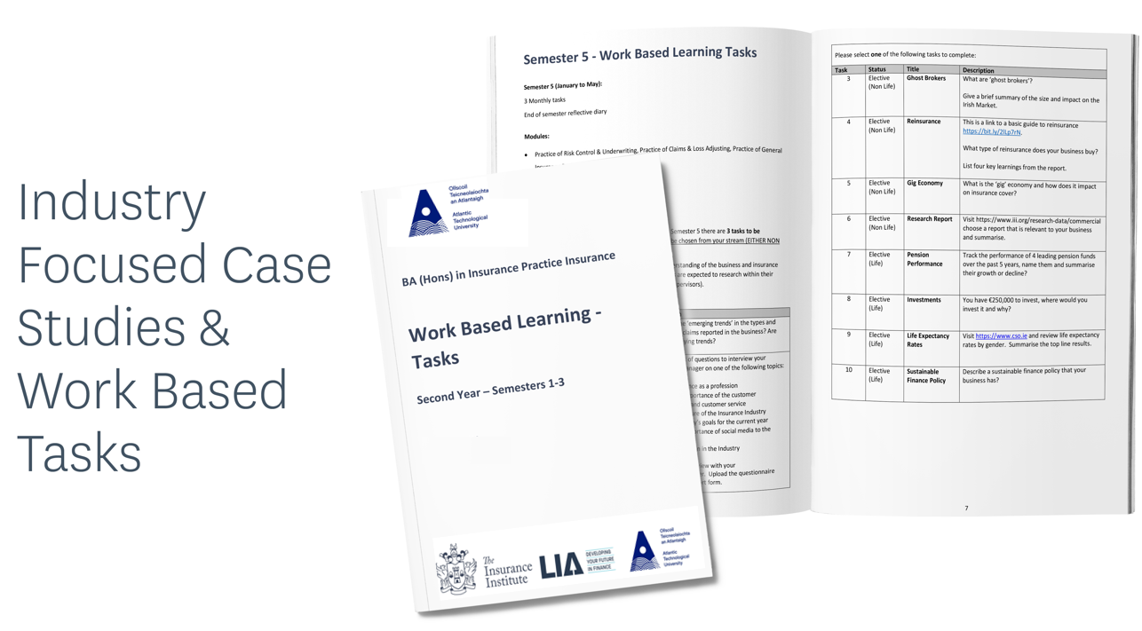

Slide 25


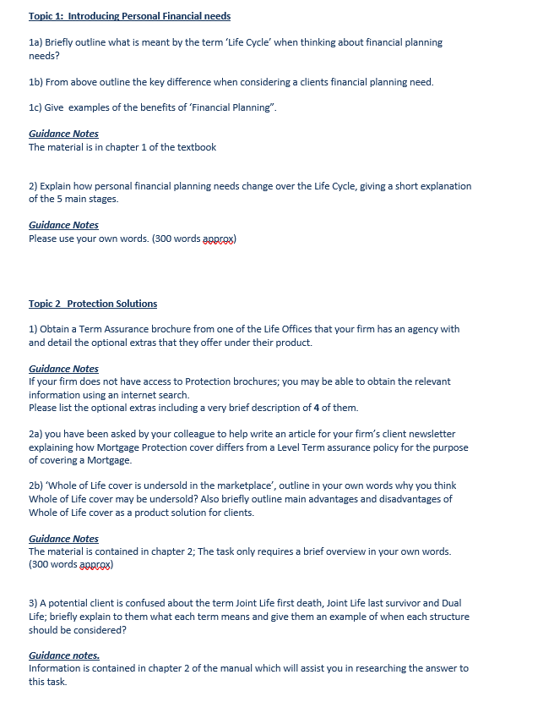
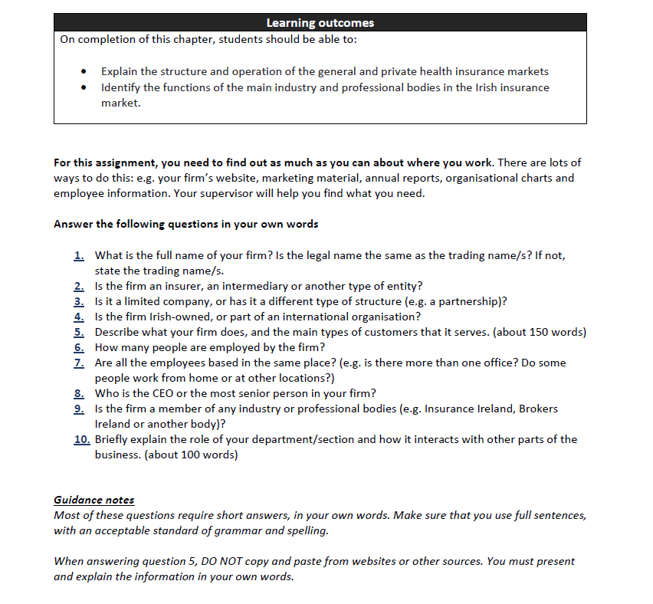
Case Studies & Work based Tasks

Slide 26
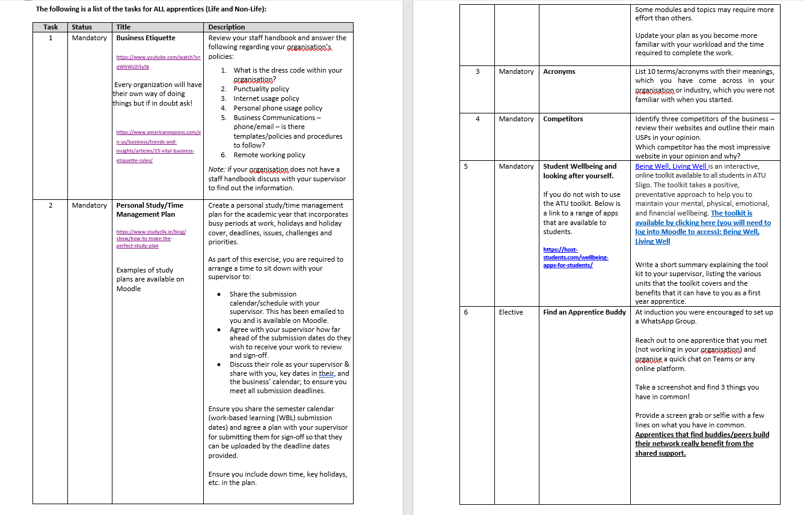
6 Mandatory and 1 Elective Task
End of Semester Reflective Diary

Slide 27
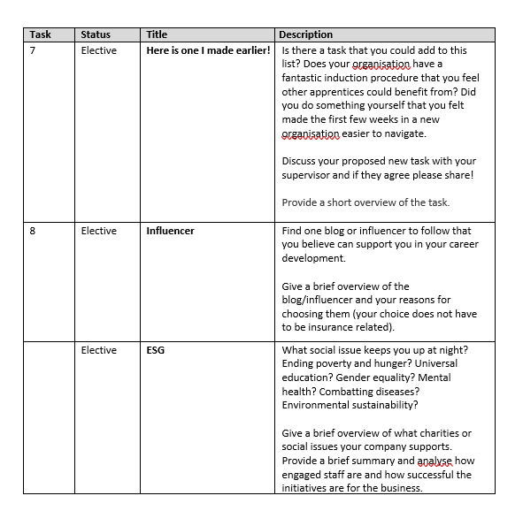

Slide 28
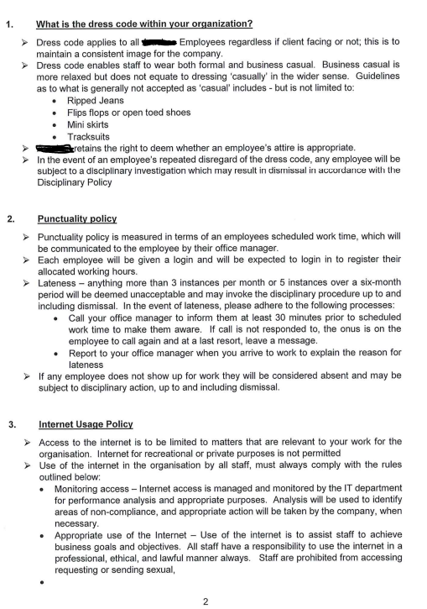
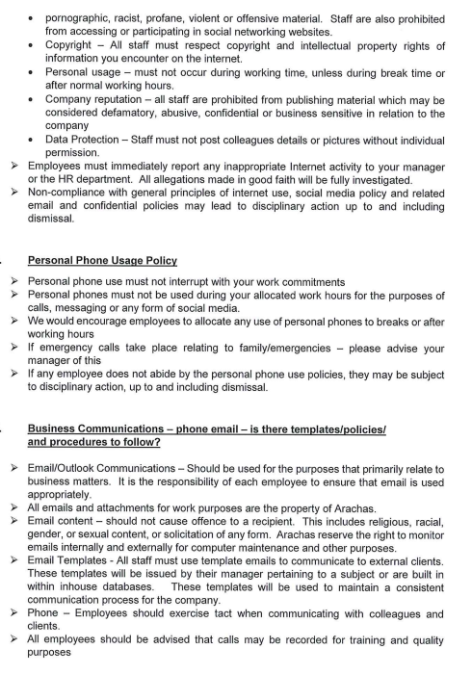

Examples: Task 1 – Business Etiquette
Example 1

Slide 29

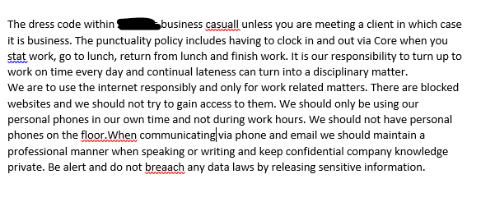
Example 2

Slide 30
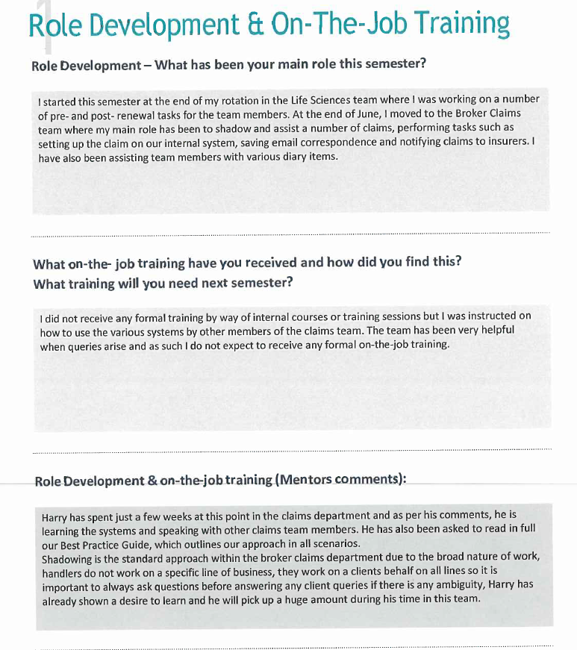

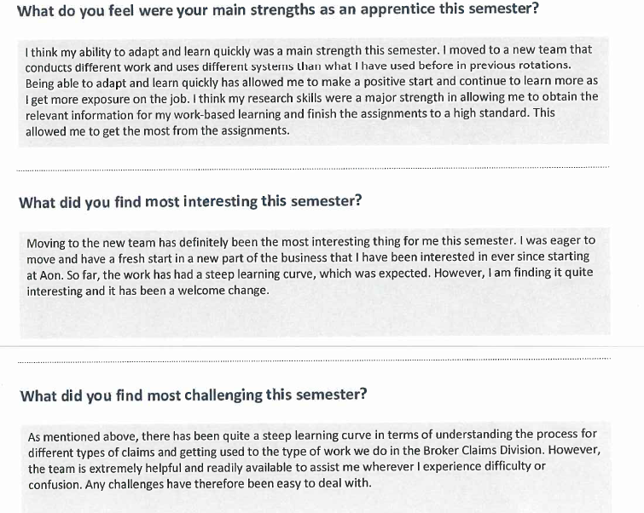

Slide 31
A Supervisor’s Perspective

Slide 32
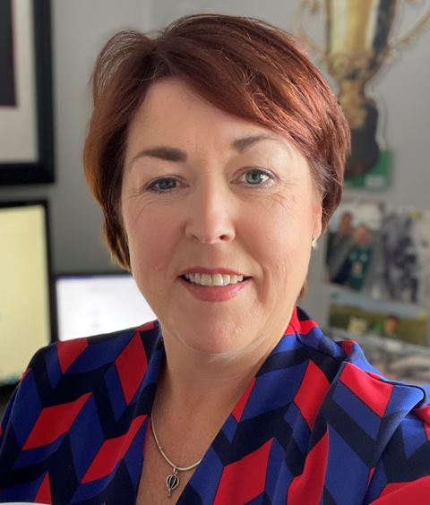
Carolyn Higgins, Davies Group

Slide 33
Thank you!
Questions Please

Slide 34
Supervisors’ Resource Centre
An email will be sent with a password after this session for access. The Resource Centre has copies of all relevant documentation
and information relating to the Insurance Practitioner Apprenticeship for both Life & Non Life Supervisors and Mentors. ​
The Resource Centre can be accessed through:
https://earnandlearn.ie/apprenticeships-employers​

